Slide 1
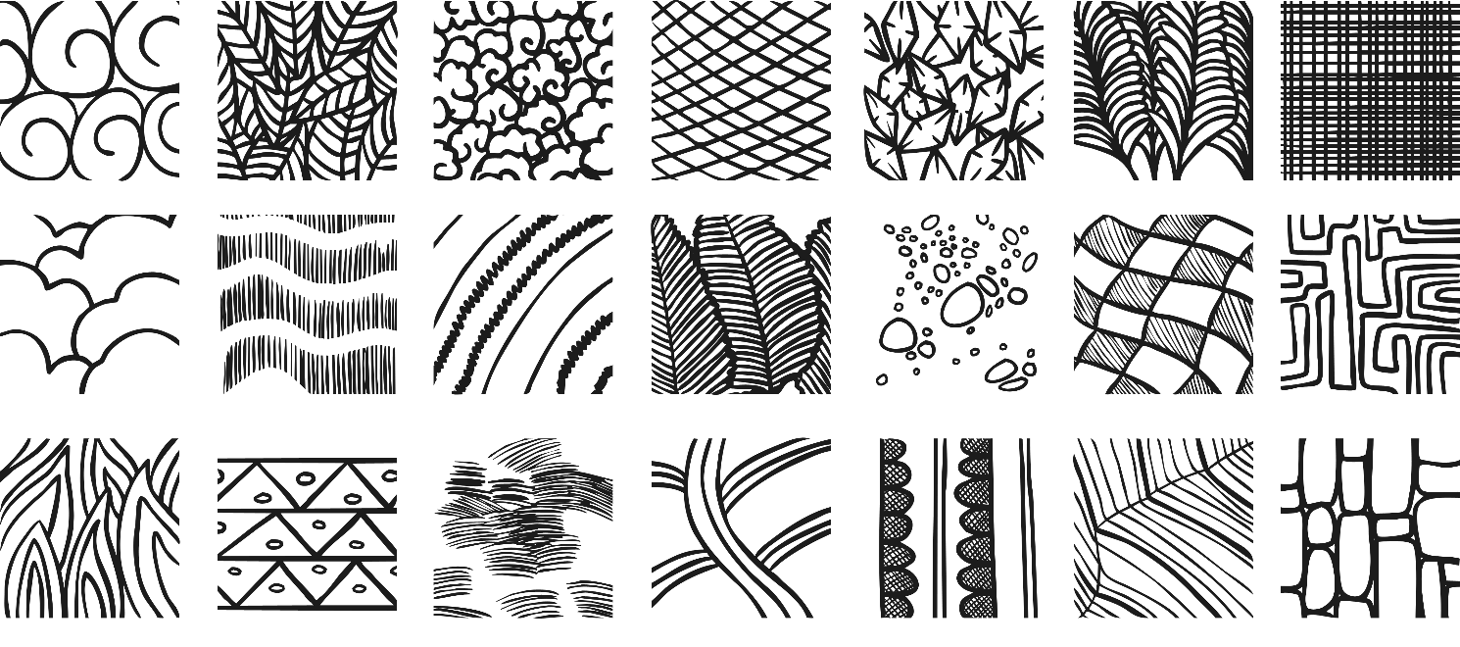
Drawing texture with pencil
Texture is the feeling, appearance or consistency of an object or material.
It can be natural or man-made, functional or decorative. Artists try to replicate the texture of the subject to make their work look as realistic as possible.

Slide 2
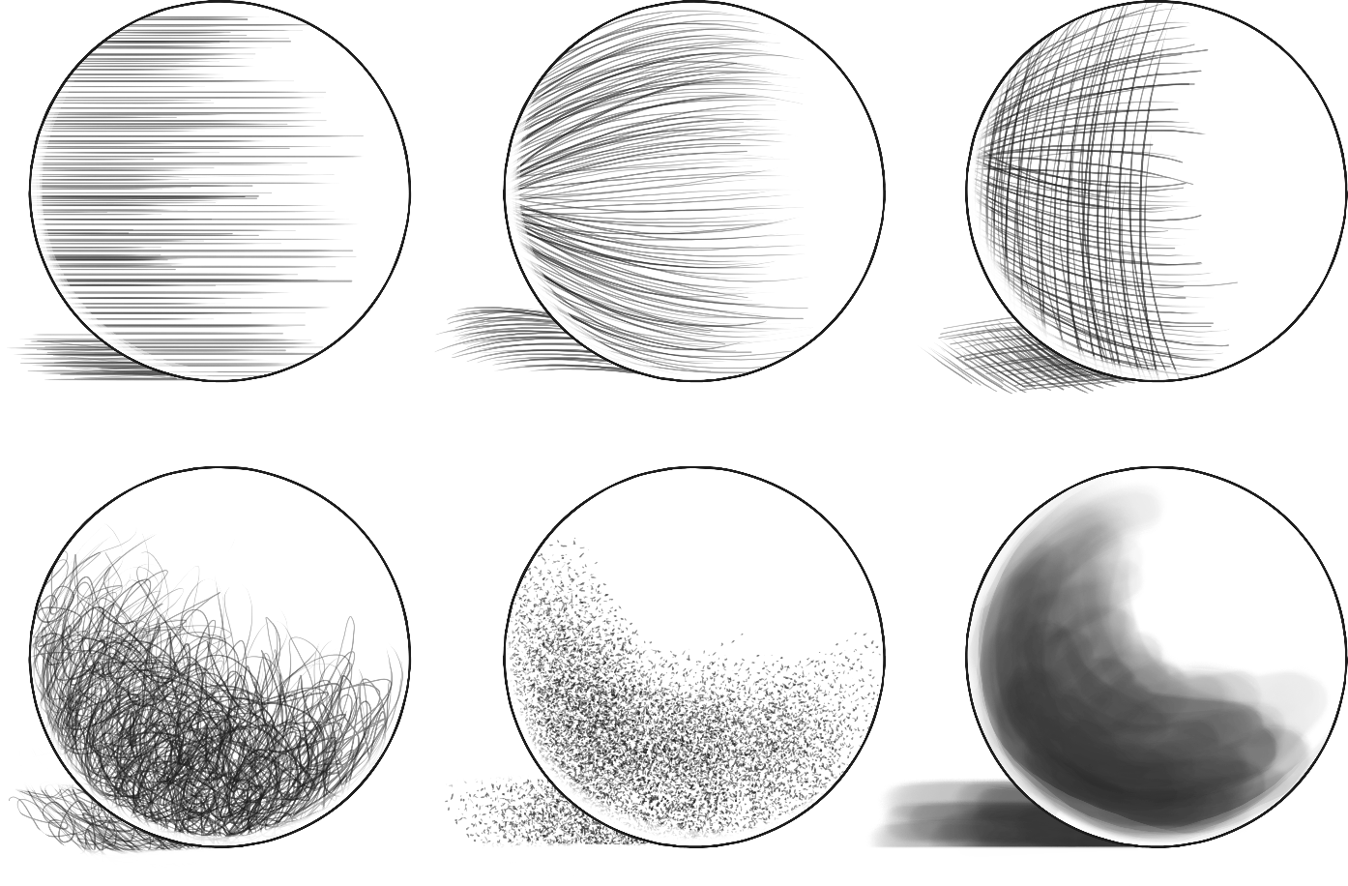
Drawing texture using line and tone
On a piece of paper, try drawing some circles like the ones below. They don’t have to be perfect!! Then, experiment drawing different textures.
Hatching
Contour Hatching
Cross Hatching
Random Hatching
Stippling
Ink Wash

Slide 3
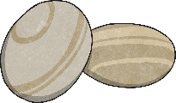

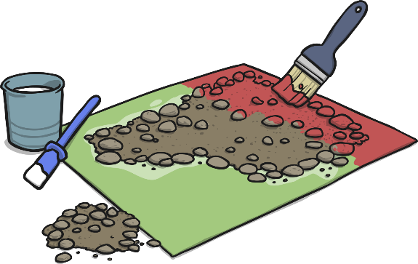
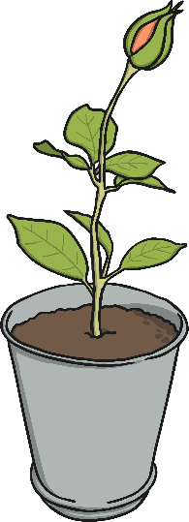
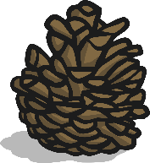
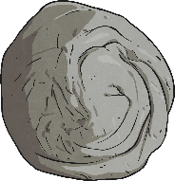
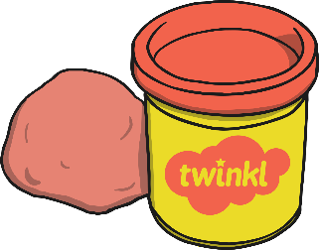

Art Activity
Different textures are all around us. Find objects or materials in your home with an interesting texture. Feel them and describe them.
Have a go at drawing them in your sketchbook, then see if you can apply the texture shading techniques we’ve just practised. Remember – we’re looking at textures here, not light/shadows or shading ☺

