Slide 1
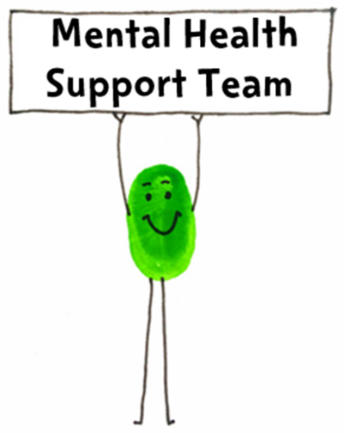




Emotional Regulation
Parent Coffee afternoon
MENTAL HEALTH SUPPORT TEAM (MHST)
Emotional Health Service
Achieving for Children
42 York Street
London TW1 3BW

Slide 2
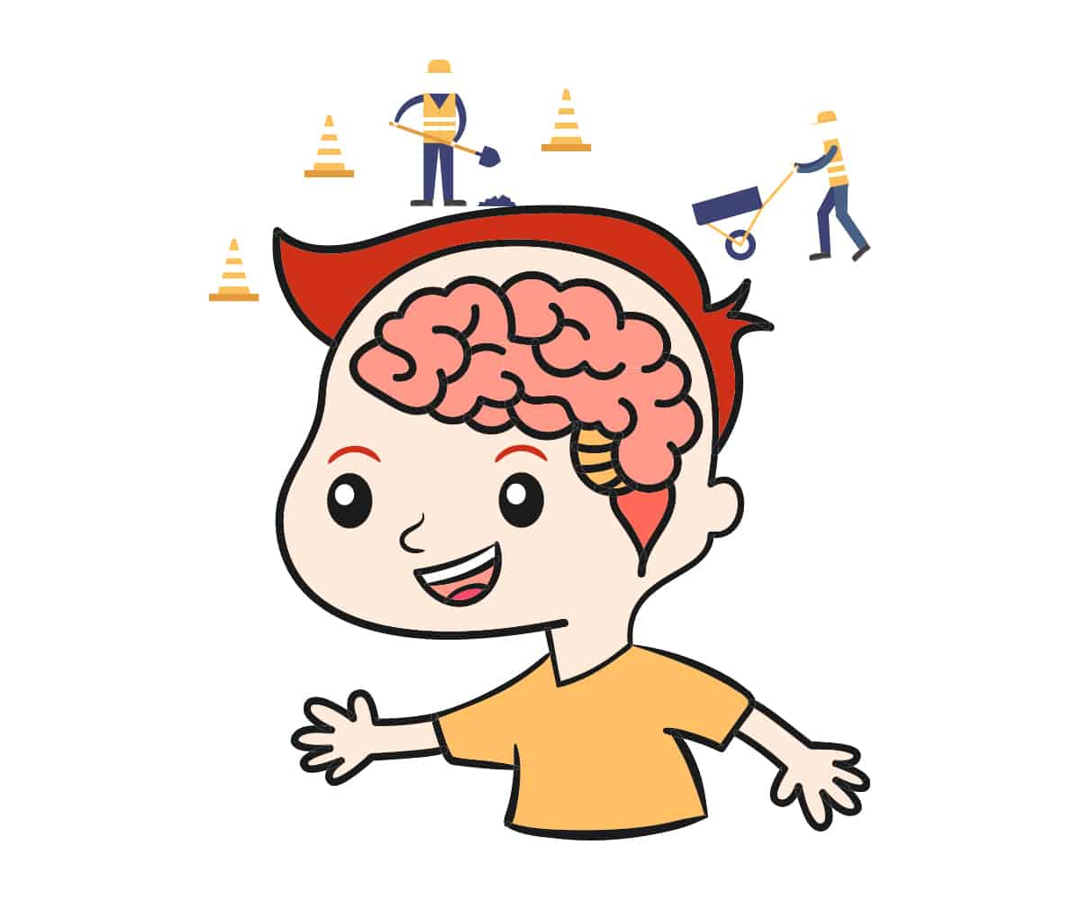
What is this coffee afternoon is all about?
The coffee afternoon aims to help you help your child in understanding emotions in themselves and how to regulate them. Children don’t know how to do this themselves, they need their parents/carers to teach them!
Notes:
we are going to give you some background information, space to think about behaviour you’re seeing and what this might mean for your child, lots of practical ideas and tools, time to ask questions at the end. We will present for around 45 minutes then hand over to you for questions.
Main aim (read slide) - Understanding what emotions look like in the body and using creative tools and visual aids can be a way to help your child in naming those emotions and finding tools to regulate them.

Slide 3
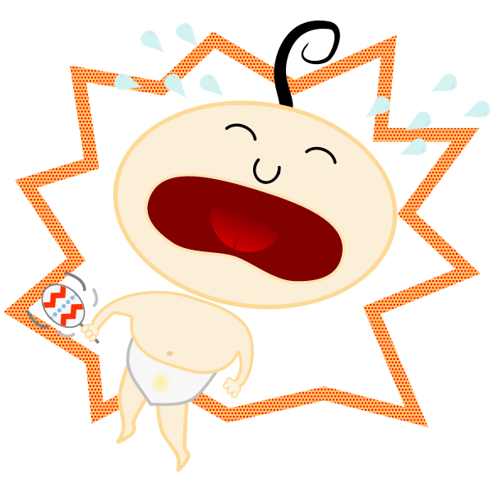
Why do we have emotions?
They help us to survive
They help us to change or process/understand situations
They help us to communicate
Notes:
WHY DO WE HAVE EMOTIONS? - ACTIVITY. Ask to briefly think back over the day and range of emotions you’ve felt. (Examples from my day - journey, other people’s emotions we’ve encountered and how they have affected us)
They help us survive, e.g. fight, flight, freeze.
They help us to change or process situations e.g. getting angry about something could help us to change it, or floods of tears can realise something we having been emotionally holding onto.
Help us communicate - pre-verbal example - e.g. a crying baby showing its parent/carer that it needs something

Slide 4
What is emotional regulation?
?
Emotional Regulation:
A person’s ability to effectively manage and respond to their emotions by:
Identifying the emotion (emotional literacy)
Thinking about the intensity of the emotion and the trigger
Doing something to manage the emotion
?
?
?
?
?
Notes:
EMOTIONAL LITERACY - Increasing the vocabulary of emotions, being able to name the feeling underneath the behaviour (harder than it sounds, lots of emotions can look like anger)
How sad/angry am I (compare this with past situations), what made me feel this way (trigger)? Different levels of the same emotion can look very different.
Managing the emotions - Having a toolbox of activities and strategies to help calm down are so useful and we are going to go onto talking through these with you later in the workshop

Slide 5

Bodily Sensations
The body can be an important tool to help us recognise our emotions. For example:
Tummy ache= worried
Fidgety= nervous/overwhelmed
Shallowed/Quick breathing= panicked/scared
Tense muscles= frustrated/angry
Making the body physically small= frightened
‘Try it out’
Notes:
Tummy ache- could mean the child is feeling worried
Fidgety- could mean the child is feeling nervous or overwhelmed
Shallowed/Quick breathing- could mean they are feeling panicked or scared
Tense muscles- could mean they are feeling frustrated or angry
Making the body physically small- could be because they are frightened
These signs might also be that the child is feeling unwell so just be curious, vocally observe these behaviours and ‘try out’ different emotions to see if any of them fit how they are feeling.

Slide 6

Behaviour - Being curious
Children often use behaviour to show an emotion
What might the child really be communicating? What is the emotion underneath?
What does the behaviour tell me about what my child needs in this moment?
Notes:
The child may have acted out because it is the only way they knew how to communicate with you if they don’t have other tools they could have used. Instead of reacting/punishing, try as much as possible to take a moment to be curious about what is underneath.
ACTIVITY: Discuss examples from group - ask them to put in chat…,
a few examples to start with could include, eg. refusing to clear up toys = sad that playtime is finished. Not putting on shoes or coat = upset at leaving parent to go to school. Destroying homework = frustration at not knowing the answer, needing more support

Slide 7
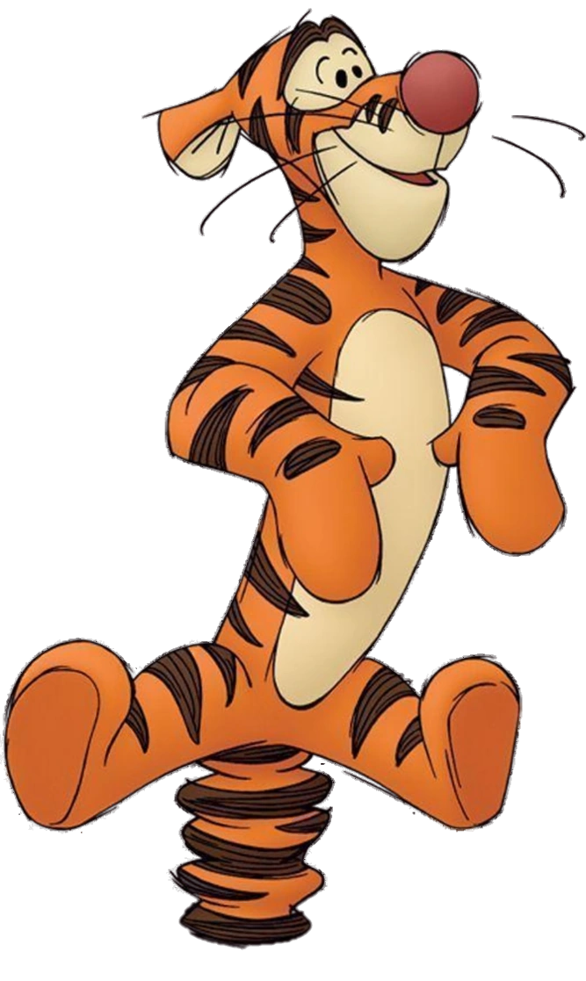
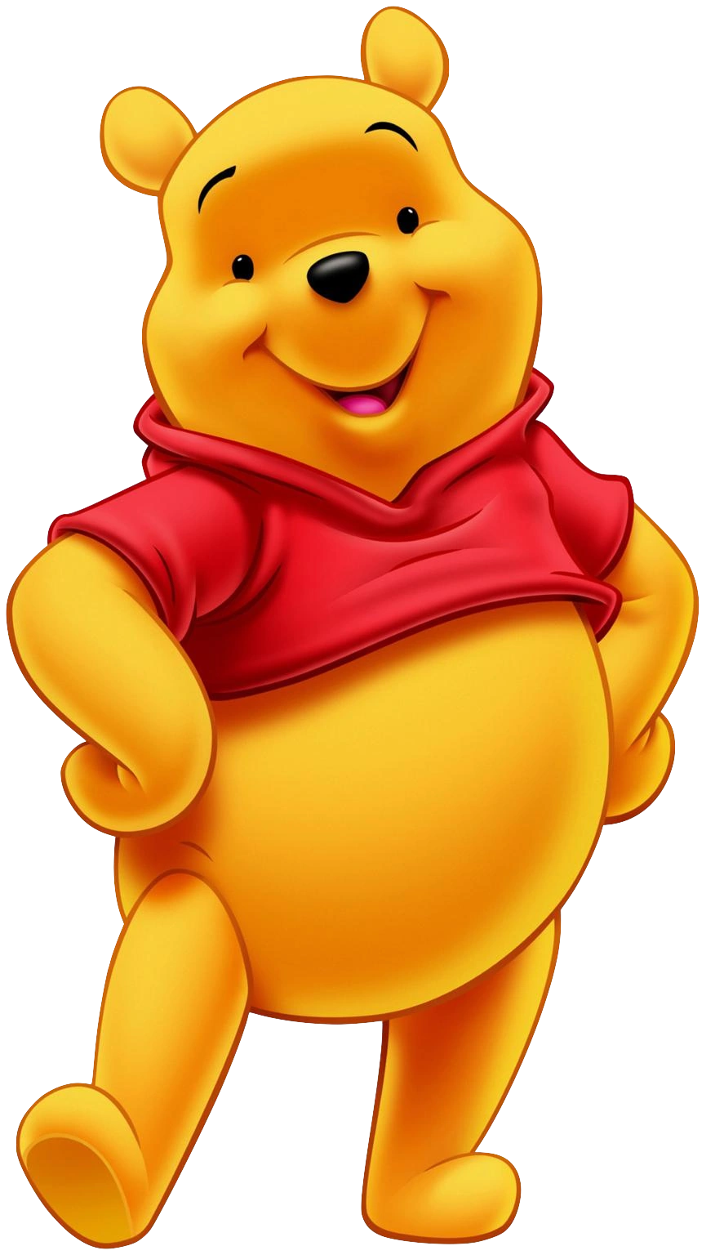
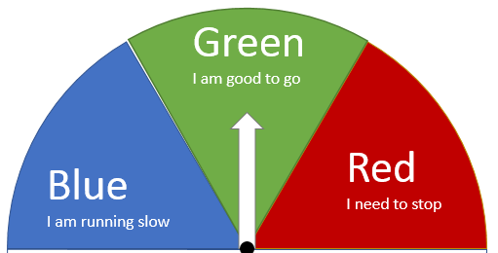
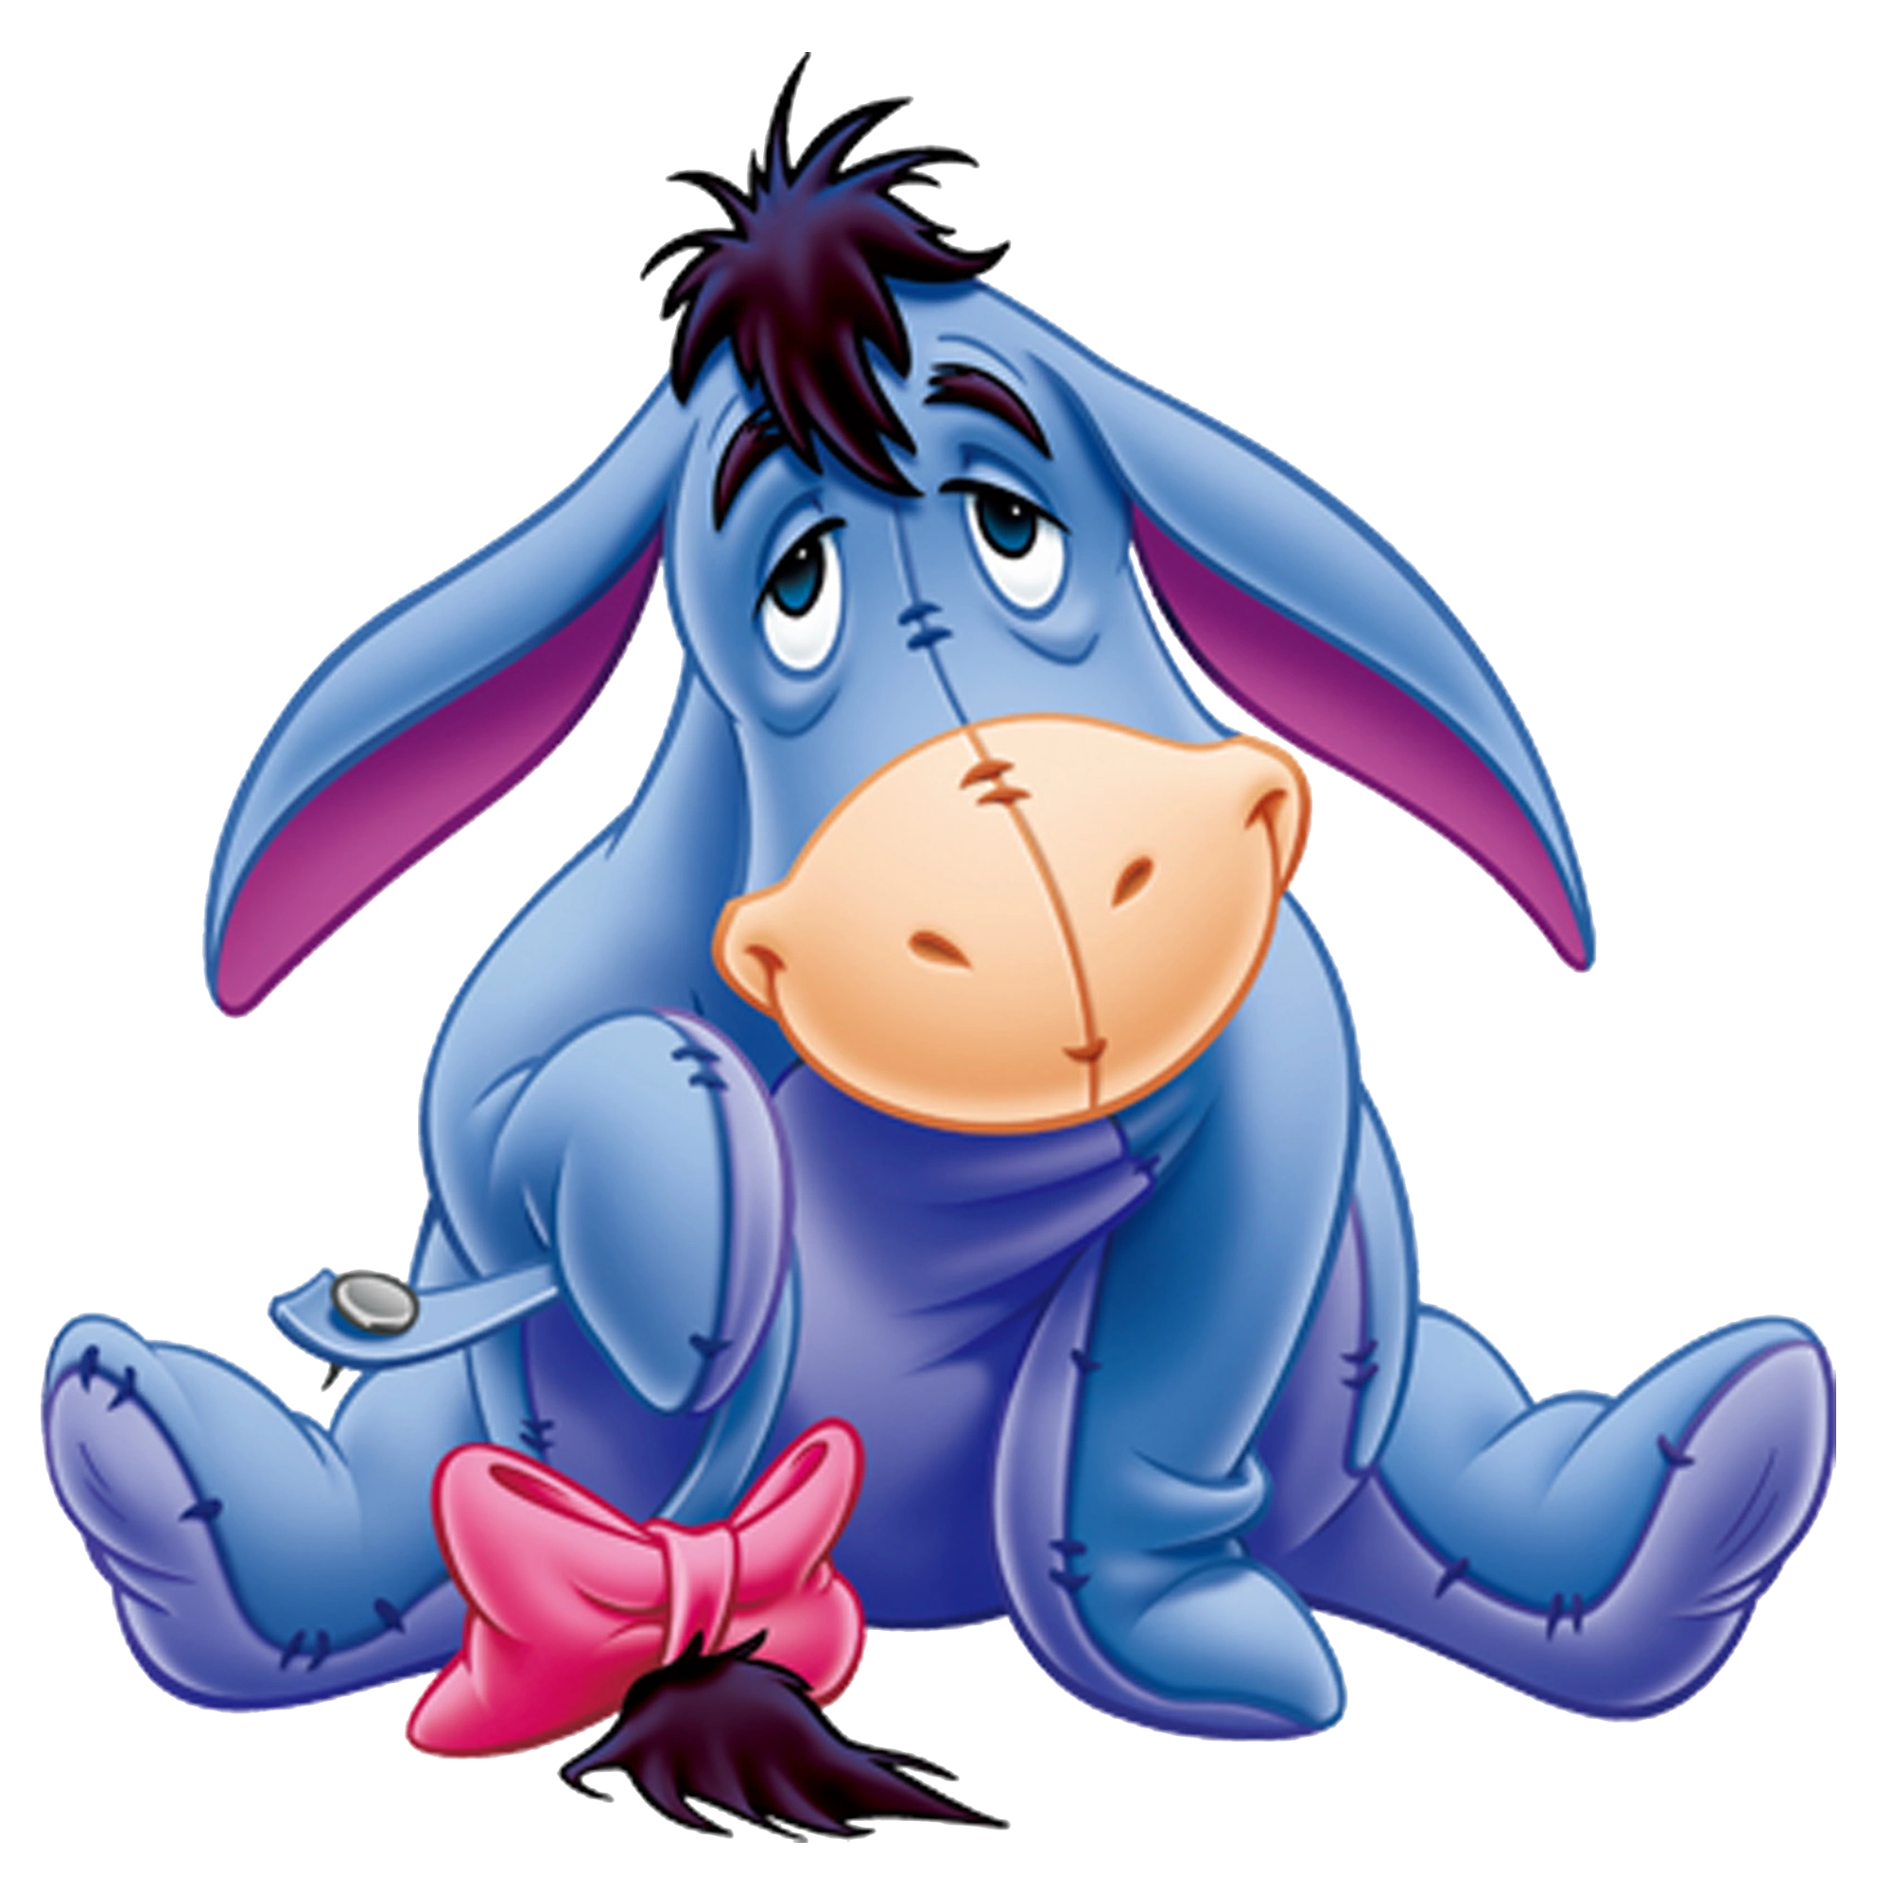
States of arousal! How is your engine running?
High
Just right
Low
Notes:
Another way of looking at behaviour related to nervous system:
Think about adult’s levels not matching child’s - we may need to adjust our speed to help them to regulate.
This can also work with Winnie the Pooh characters.

Slide 8

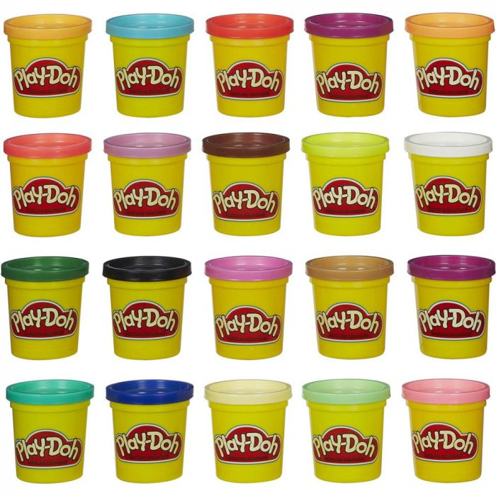
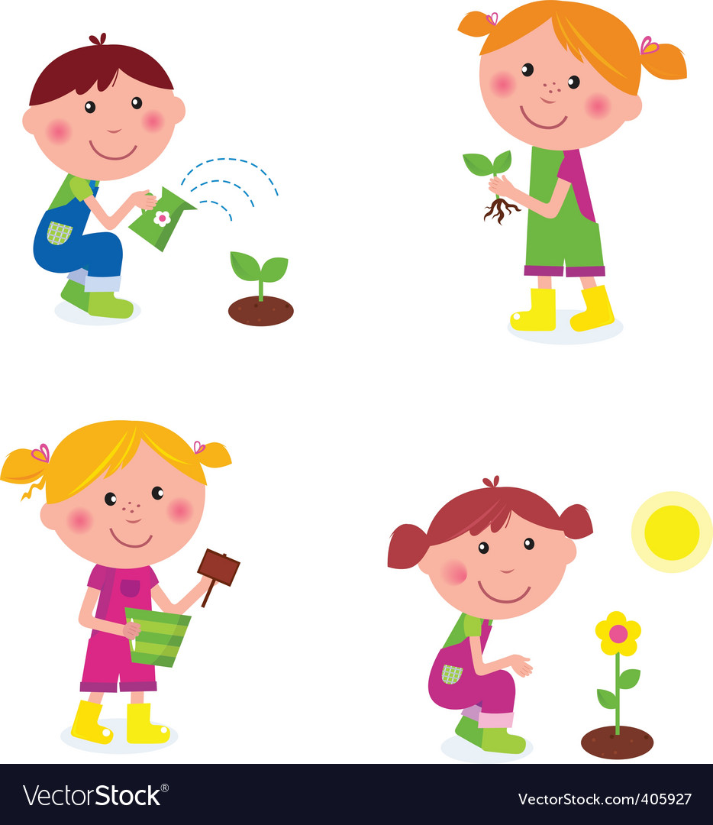
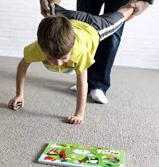

Down regulating activities
Notes:
Down regulating activities are good to use when your child is in the yellow zone as it can help ground them and calms and organises the nervous system
Carrying a rucksack, helping carry things around the house
Wheelbarrow walks
Squashing between cushions
Mixing, Kneading- playdoh, slime, putty
Helping in the garden
Hugs, ‘deep pressure’

Slide 9



Up regulating activities
Chasing/running/spinning/using playground equipment
Start/Stop games
Putting on some music that they like and dancing/singing along
Pay attention to surroundings: count how many things you can see of one colour
Eat or drink something with a strong taste: lemons, peppermint sweets, something spicy etc
Notes:
Up regulating activities are good to use when your child is in the blue zone as it can boost their energy and make them more alert.
Hypoarousal - spinning, playground (over, under, around), chasing (warning that these can work very quickly - just choose one!)

Slide 10
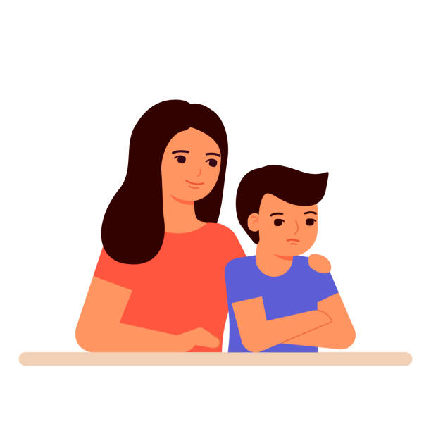
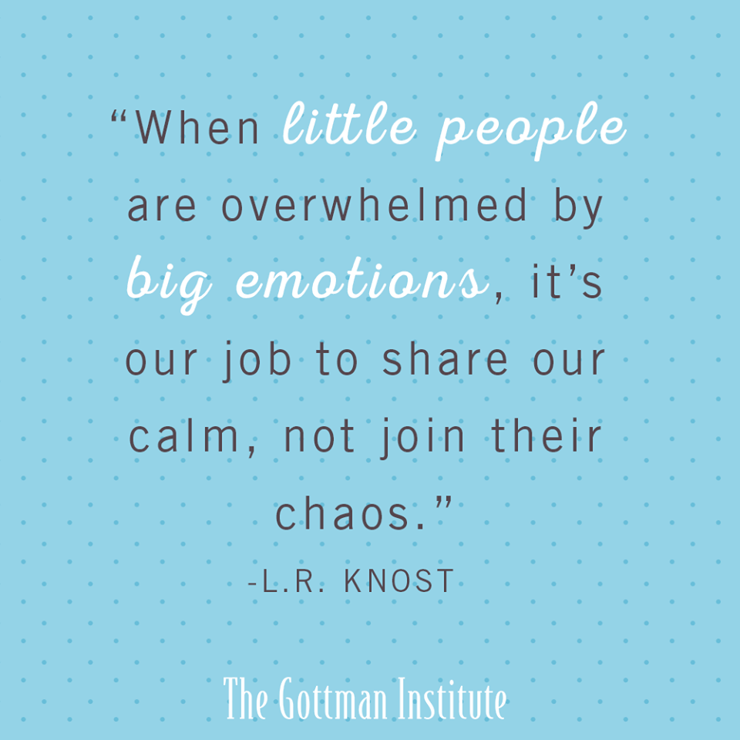
Take a deep breath…..!
Notes:
Staying calm in situations can be easier said than done but it can be an important tool to help regulate your child.
If they can see that you are calm, they can try and match your emotion and breathing to regulate themselves - this is often called co/mutual regulation. When our children were babies we will have done this all the time, think about all the soothing noises parents make…. Cuddles, stroking. Young children still need this from their parents at times when they are feeling overwhelmed.
ACTIVITY - breathe bubble

Slide 11
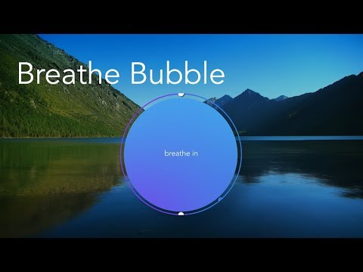
Notes:
ACTIVITY - breathe bubble. Halfway through, brief pause for a minute. (From Calm app, lots of useful tools on here)

Slide 12
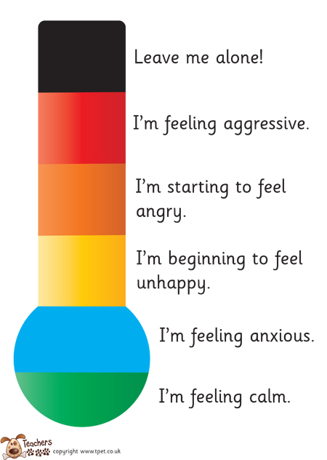
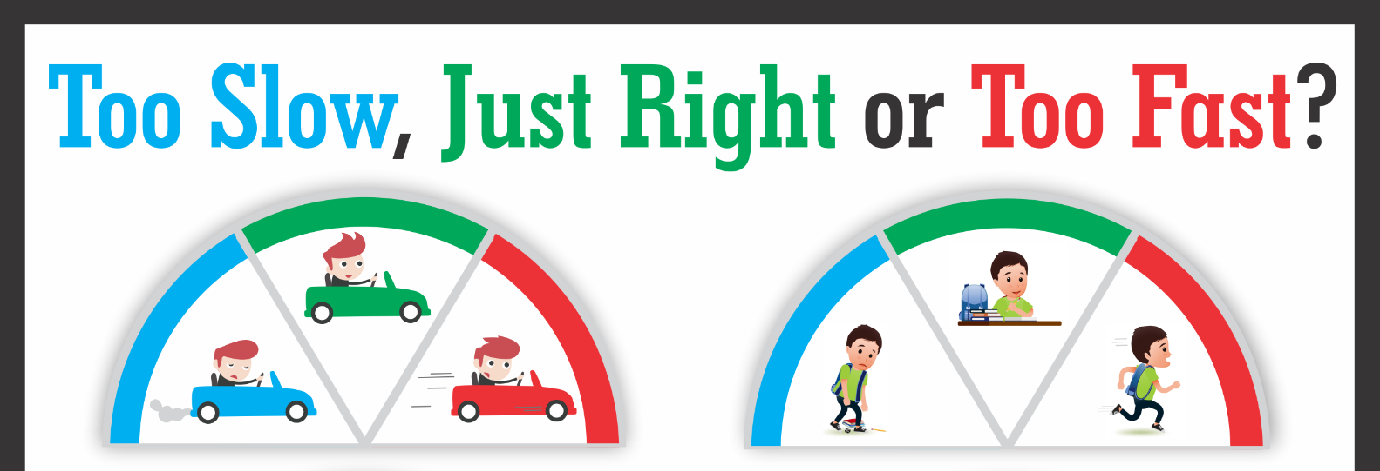
Visual tools for supporting your child to regulate their emotions
Notes:
Emotions cards can also be a useful tool for communicating, if your child is feeling a particular emotion but is struggling to verbally communicate with you having some emotions cards to hand means the child can identify how they are feeling in the moment with the cards and show you so you can understand how they are feeling and help them regulate it.

Slide 13
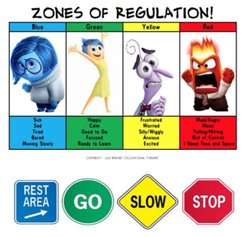
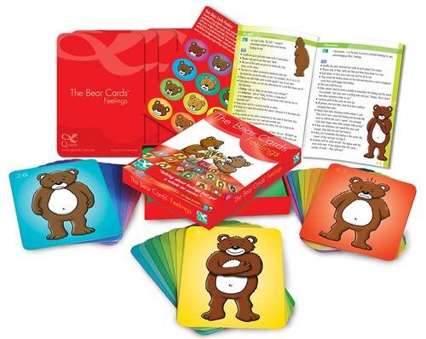
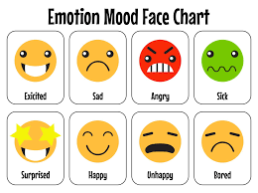
Visual tools for supporting your child to regulate their emotions
Notes:
Emotions cards can also be a useful tool for communicating, if your child is feeling a particular emotion but is struggling to verbally communicate with you having some emotions cards to hand means the child can identify how they are feeling in the moment with the cards and show you so you can understand how they are feeling and help them regulate it.

Slide 14
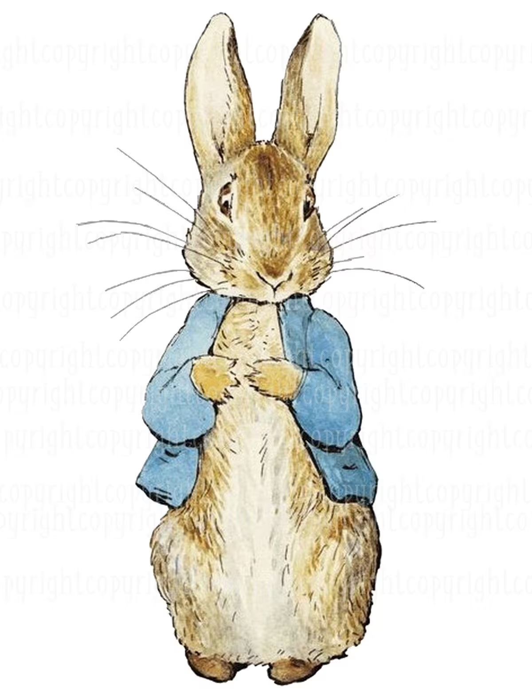
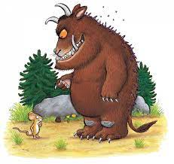

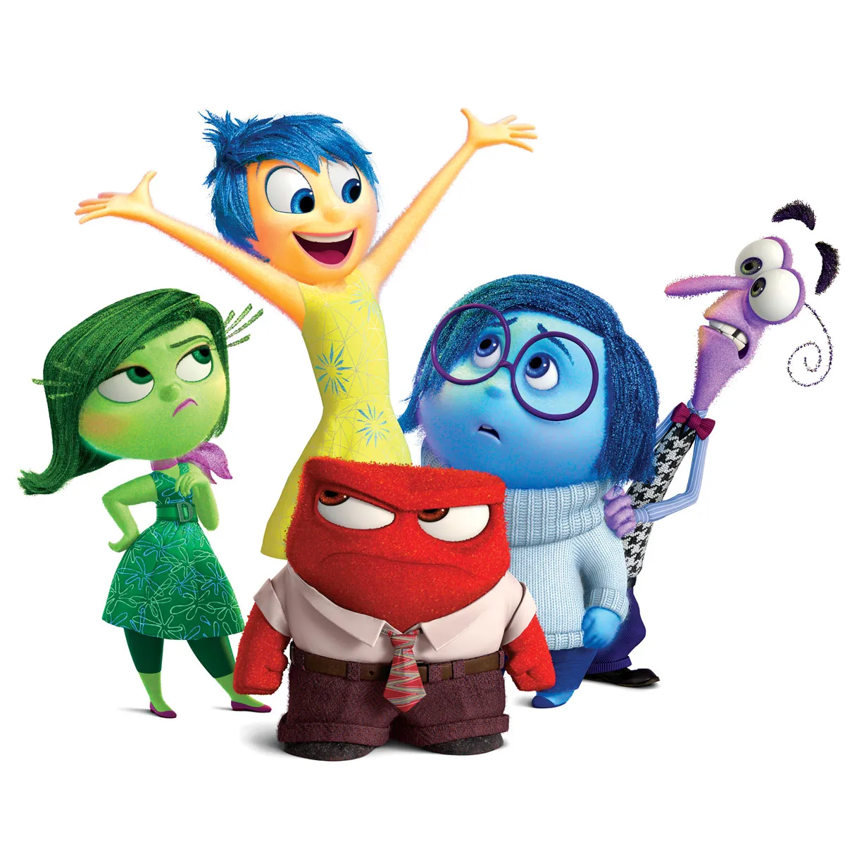
Communication and Visuals:
Ask how characters in books and films may be feeling
Avoid ‘good’ or ‘bad’ labels for emotions
Notes:
When you’re watching a film or tv together or reading a book, asking your child what they think the character may be feeling can be good visualizations and examples for emotions. ‘Inside Out’ is a good film for this (prob from 5 or 6 upwards) as each emotion has a particular, individual character but anything can work.
For example, Encanto…asking them what Bruno may be feeling having to live secluded in the house, or how Antonio may feel when he finds out his gift.
Ask them to act out the emotion, trying it out can support them to understand the vocabulary and physical sense of different feelings

Slide 15
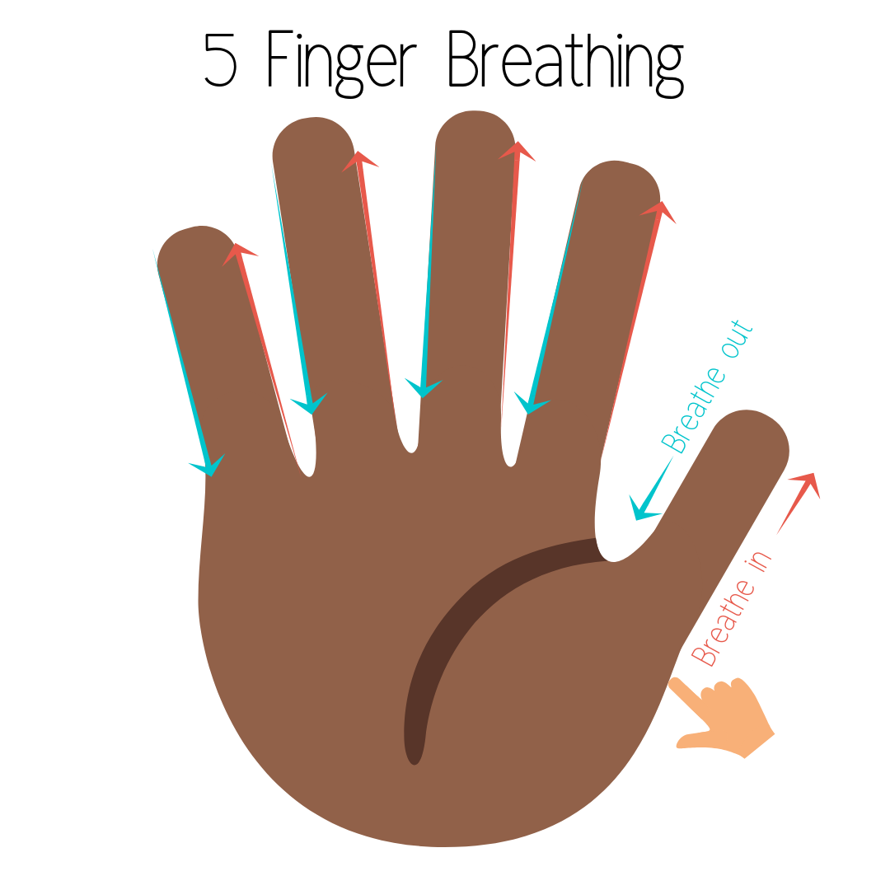
Tools for Regulation
Trace the outline of your hand with a finger
Move slowly
Inhale through your nose as you move up your finger
Exhale through your mouth as you move down a finger
Continue for all 5 fingers
Notes:
Finger breathing can be a good tool to help calm your child down if feeling overwhelmed with emotions as it gives the child a visual to help them focus on their breath. It can also provide a calming sensory input from the finger tracing.
Doing the five finger breathing yourself with your child can show your child that you empathize with them, you could also get them to trace your hands so there is an element of physical touch and focused attention to help calm them down. Try it with me

Slide 16
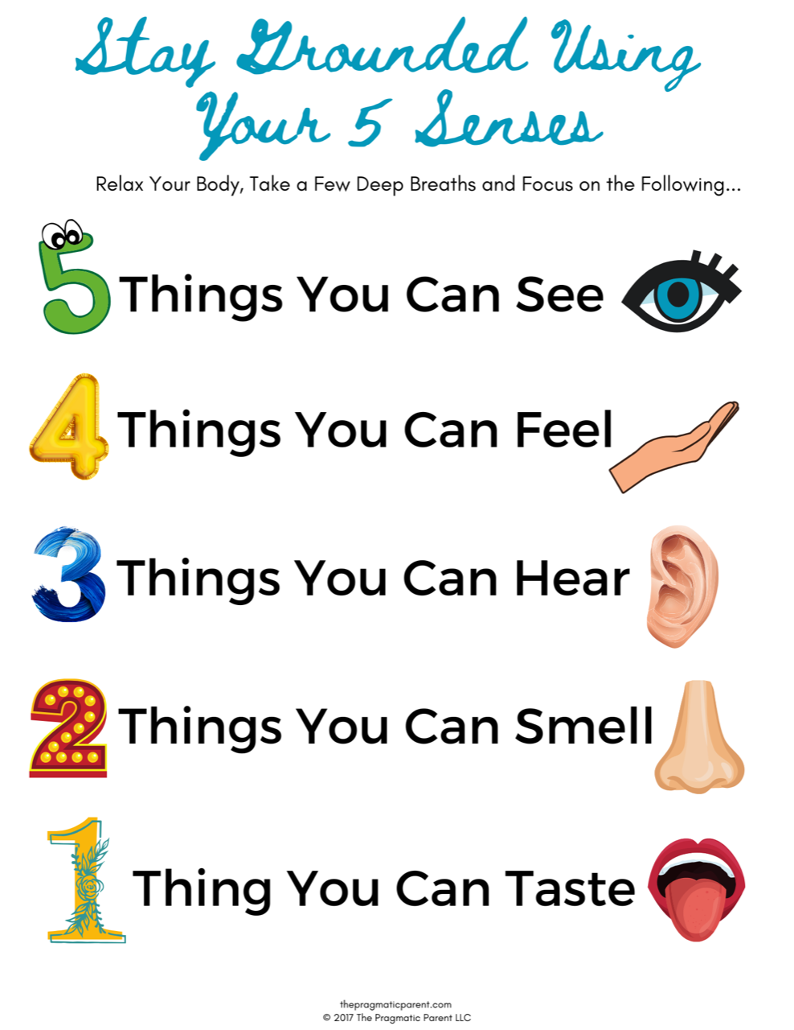
Tools for Regulation
Notes:
This is a grounding tool and can be used as the child is in their heightened emotion or as they are beginning to calm down.

Slide 17

The Prefrontal Cortex
Physical Contact
Sensory stimulation and warmth to help calm and regulate the body.
Notes:
Sensory stimulation and warmth and help calm and regulate the body.
It could be from a hug with an adult or a self hug, putting one hand under the armpit and crossing both arms over the chest.
Not all children will want or need a big cuddle, some may need a shoulder squeeze, help putting on their coats that allows for a short hug, some might want to hold hands. This can also be incorporated into the bedtime routine, when putting the towel round them after a bath to give them a big squeeze or when dressing them for bed whilst getting them in their pyjamas.The unique sensory needs of each child will be clearer to those who know them best.
Consent is also important- asking the child if they would like to be held can be important as it may not be what they want in that moment and therefore might give them sensory overload.

Slide 18

Physical Contact
Overstimulated
Deep pressure
Grounding
Regulation
Rocking
Notes:
Cradling your child and/or rocking them back and forth can help them feel contained, especially when this is done with a parent or carer. The rhythmic rocking can help them regulate and try and focus on their breath as you both sway together. This could be done as their emotions begin to calm down.

Slide 19
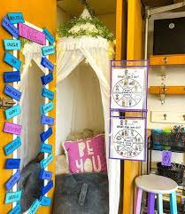
Calm down space
Notes:
Creating a safe space where children can go to regulate and calm down. This can have soothing resources e.g. blanket, sensory toy, calm box, colouring sheets.
It is helpful to create the space with children and discuss how they can use the calm down space/ corner when they are calm and ready to engage.

Slide 20
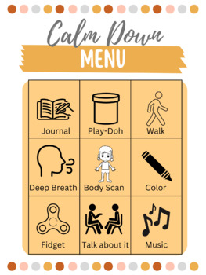
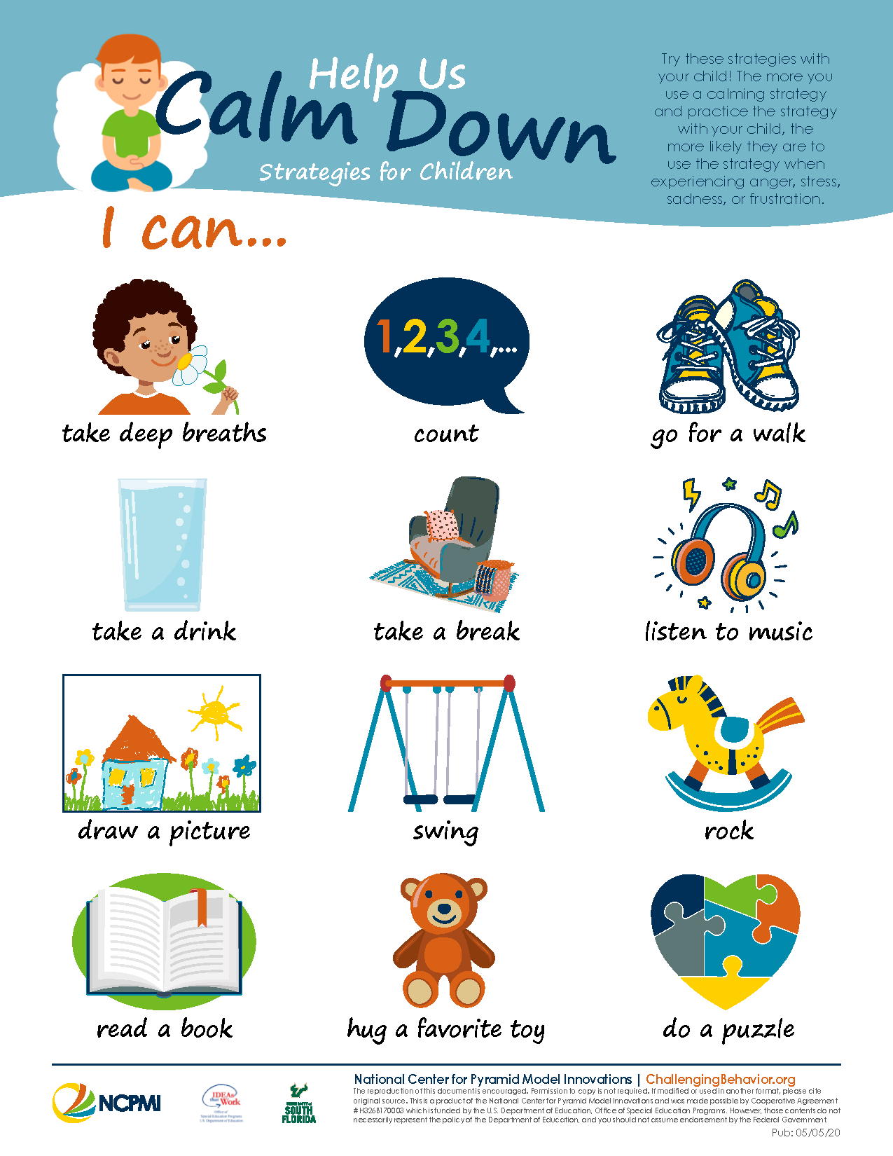
Calm Down Menu
Notes:
Giving your child a calm down menu can help them communicate to you what they need when they are feeling emotional. This can be printed out and put in an easy place to find like on the fridge so when the child is feeling overwhelmed by a certain emotion either they can get the menu and tell you what they need, or you can remind them of the menu by showing them and asking what they feel would be useful in that moment. This menu can also be tailored to each child by adding particular techniques that your child likes e.g. for exercise you could specifically place football in there if that is what they are interested in.
Please put any other ideas in the chat that you’ve use or would like to try with your child.

Slide 21
Modelling emotions for your child
How do you respond to stress?
How do you destress? What helps you?
Talk about your own emotions e.g. “I’m feeling quite frustrated today because…I’m going to … to help me calm down” and model emotion regulation
Notes:
Reflect on how you respond to certain situations and verbalise those with your child. This can help them understand what emotions look like on you and gives them ideas for strategies that you use to regulate so they can use them when they are feeling those emotions.

Slide 22



Crisis curve
Rumbling stage … start to notice upset
Recovery stage
Daily routine
Daily routine
Rage Stage
Most extreme
Children may also withdraw
Do not reason or problem solve
Calm redirection can be used

Slide 23
Helpful Parent Behaviours
Rumbling Stage Stay calm Talk quietly Take deep breaths Stay close ( if your child wants this) Avoid conflict Don’t get into a power struggle Be empathetic and understanding Use some calming or grounding strategies Attempt to distract or redirect | Rage Stage Protect your child and others from harm Don’t punish Don’t take your child’s behaviours personally Remove any witnesses Be aware of your body language Avoid conflict Remain calm | Recovery Stage Be aware your child may return to the Rage stage Give your child time to become calm Offer gentle redirection and distraction Use calming and relaxation strategies Allow sleep Be aware that your child may become upset, embarrassed, feel guilty or shame and want to say sorry Don’t talk about the rage behaviours unless they want to

Slide 24
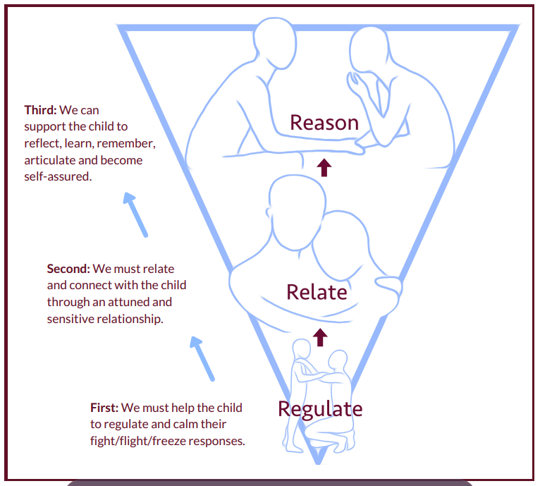
Timing is important!
Notes:
Don’t forget timing when you are responding to your child’s emotions….
when someone (adult or child) is emotionally dysregulated, we can’t go straight to reasoning. FOCUS ON REGULATING FIRST - We need to calm the brain-stem by regulating; the emotional part of the brain by relating and only then, once we’ve accessed the thinking brain, can we reason. Don’t waste time trying to reason or expect an apology when emotions are still high.

Slide 25
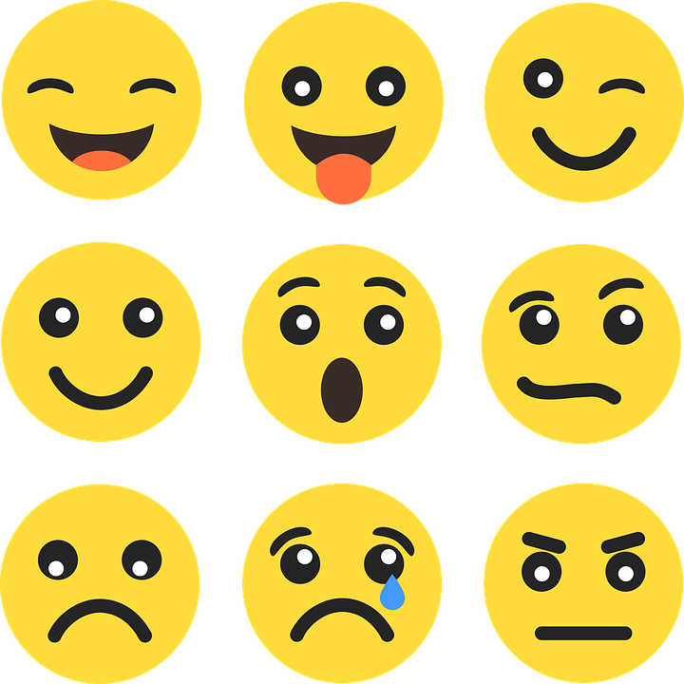
Emotional Validation
Stay with the emotion they are feeling
Name emotions
“Wow, you seem really angry!”
“You look surprised”
“You seem very frustrated..what can we do to help that?”
Try not to fix, rescue, or try to talk children out of their feelings
Notes:
Naming emotions can help the child try on different emotions that they may be feeling and find out what emotion fits best with how they are feeling (they will let you know if you’re way off the mark!). Naming emotions can also help them understand what particular emotions look like on them, allowing them to put a feeling or visual to the name, in turn being able to spot it in themselves next time and be able to verbally communicate that.
It also helps with understanding what emotions look like on others and therefore developing their ability to empathize with others around them.

Slide 26
Tools for Regulation
Empathy
Mirroring
Touch
Consistency
Co regulation
Voice
Notes:
In early life the nervous system is unable to regulate emotional turmoil and relies on the significant carer to help modulate the distress so that self-regulation can be internalised, children learn to self-regulate being watching how others regulate.
Empathy- putting yourself in their shoes, showing the child that they have their own thoughts and feelings and seeing that another person understands them can help them feel less isolated and alone.
Touch- connecting with a child and making them feel less overwhelmed.
Voice- having a calm voice and rhythm can help give them a sense of being supported, allowing no sudden shocks and surprises to dysregulate them.
Co regulation- being close an adult who is in a state of calm can help the child reduce their stress.
Mirroring- discussing with the child what you think they might be feeling so they can have a sense of validation.
Consistency- A consistent, safe and predictable environment is a significant source of comfort and help.

Slide 27

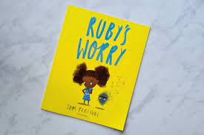

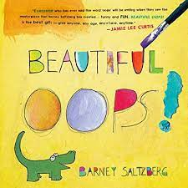
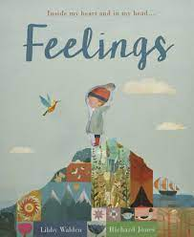
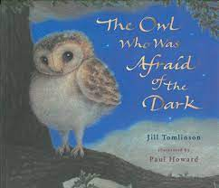
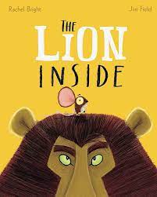
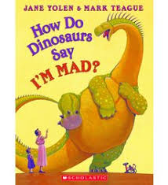
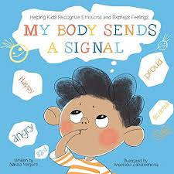
Books about feelings
Notes:
Ask your child’s school if they have any books you can borrow, order these from the library

Slide 28
Useful Resources
BBC Bitesize (parents toolkit, wellbeing)
Cosmic Yoga (Youtube channel)
Calm (app and Youtube meditation videos)
Your Mindful Garden (CBeebies)
Young Minds website (lots of resources for parents and children/teenagers around wellbeing and mental health). Parent/carer advice helpline 0808 8025544
Mighty Cards - wellbeing ideas and calming activities for 4-11 year olds
The Body Scanner! Mindfulness for Children
Belly Breathing: Mindfulness for Children
Butterfly Hug! 6-Minute Self-Soothing Meditation For Children Using The Butterfly Hug Technique.

Slide 29
Your School Mental Health Support Team
The Mental Health Support Team (MHST) is an early intervention team of mental health practitioners who provide emotional wellbeing support to children, young people, families/carers and staff in school settings, within Kingston and Richmond. The teams are delivered by Achieving for Children as part of our Emotional Health Service.
If you would like further support from our team, please speak to the Mental Health Lead staff member at your child’s school, or you can contact us at:
Mhstbusiness.support@achievingforchildren.org.uk

Slide 30
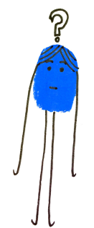
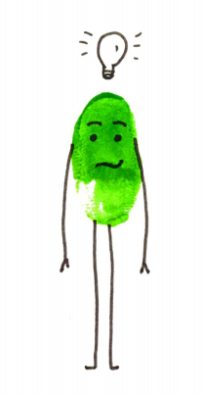
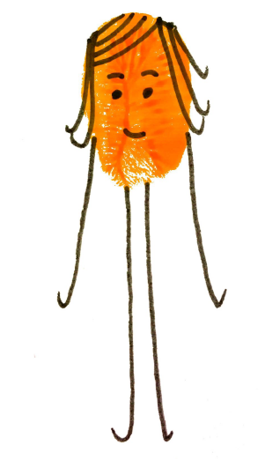
Questions - Ideas - Feedback
Contact us on: mhstbusiness.support@achievingforchildren.org.uk.

