Slide 1

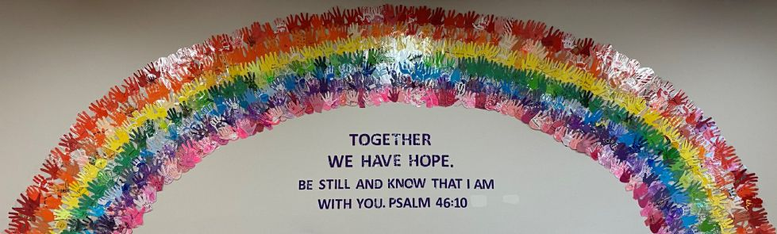
Our Learning Certainties

Slide 2
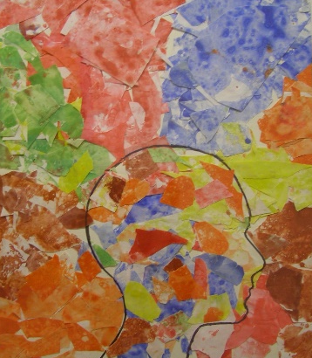
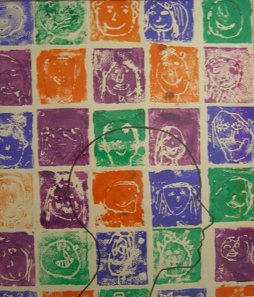
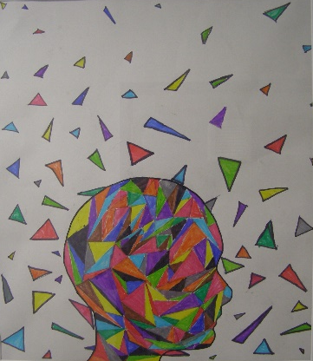
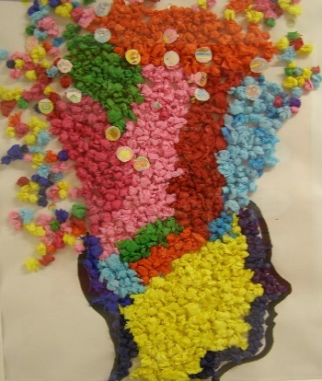
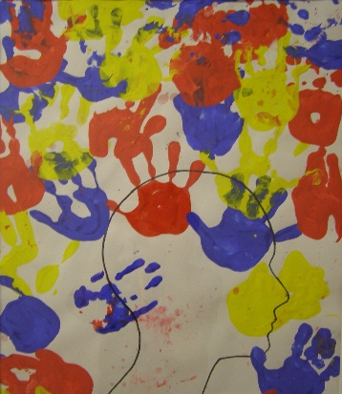
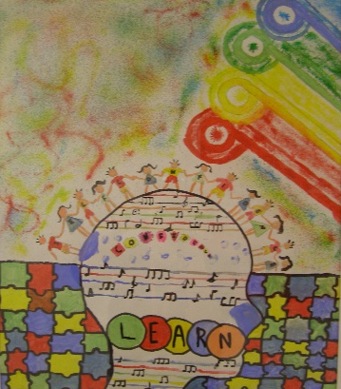
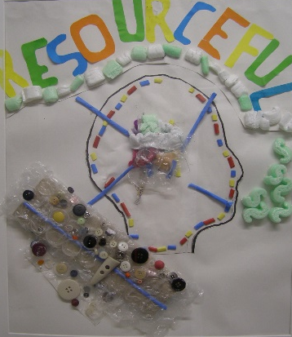
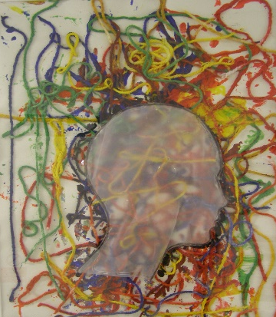
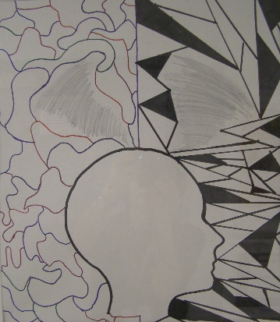
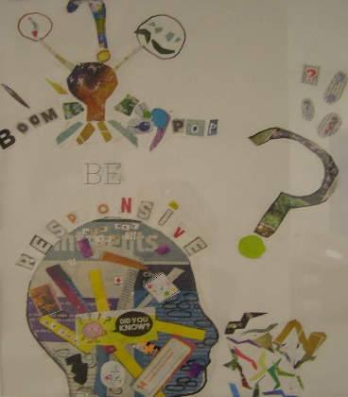
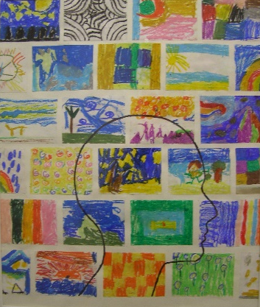
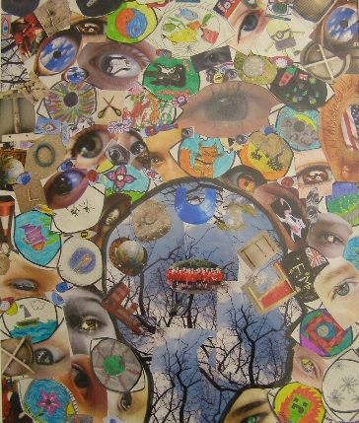
Our Learning Certainties
Good learners are:
Enthusiastic
Motivated
Resilient
Imaginative
Inclusive
Confident
Resourceful
Determined
Flexible
Responsive
Independent
Focused

Slide 3
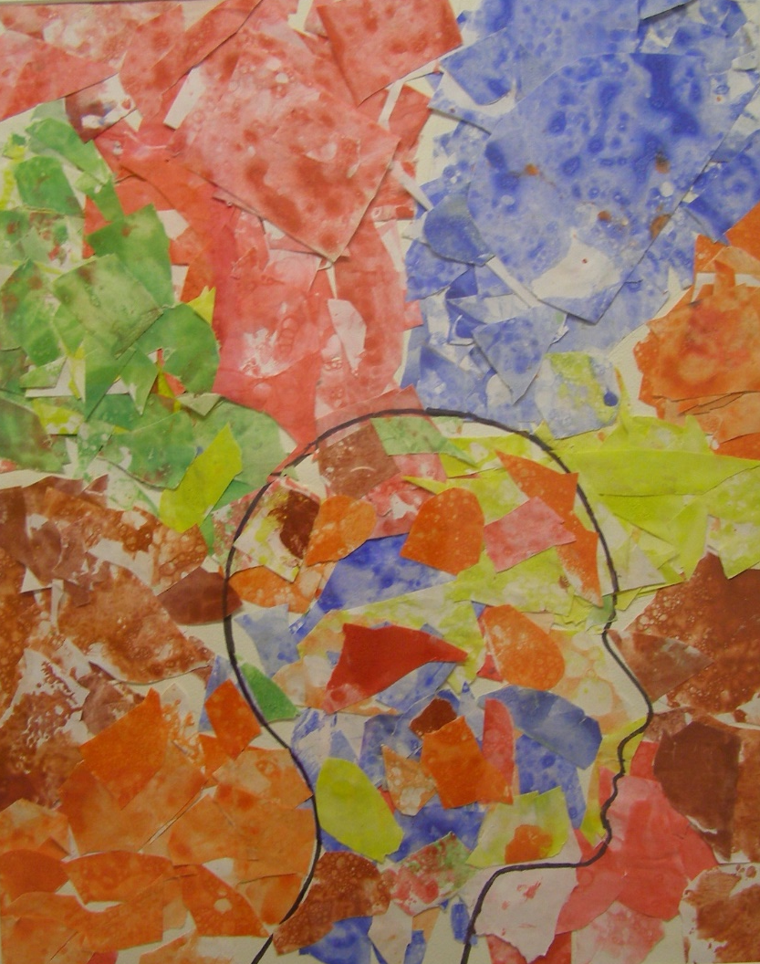
Luke chapter 19
The story of Zacchaeus the tax collector
“ Jesus entered Jericho and was passing through. 2 A man was there by the name of Zacchaeus…”
Enthusiastic
I feel proud of my achievements
I am always keen to try my best
I can be curious and want to find out more
I can use my positive energy
I can involve myself and join in
I can have fun in my learning

Slide 4

Motivated
Matthew chapter 7
The story of The Wise and Foolish Builders
“Therefore everyone who hears these words of mine and puts them into practice is like a wise man who built his house on the rock...”
I can keep my goals and targets in sight
I really want to learn
I participate positively in all my learning
I can stay positive in whatever I am doing
I can work hard to achieve my best
I can smile and say ‘I can’

Slide 5
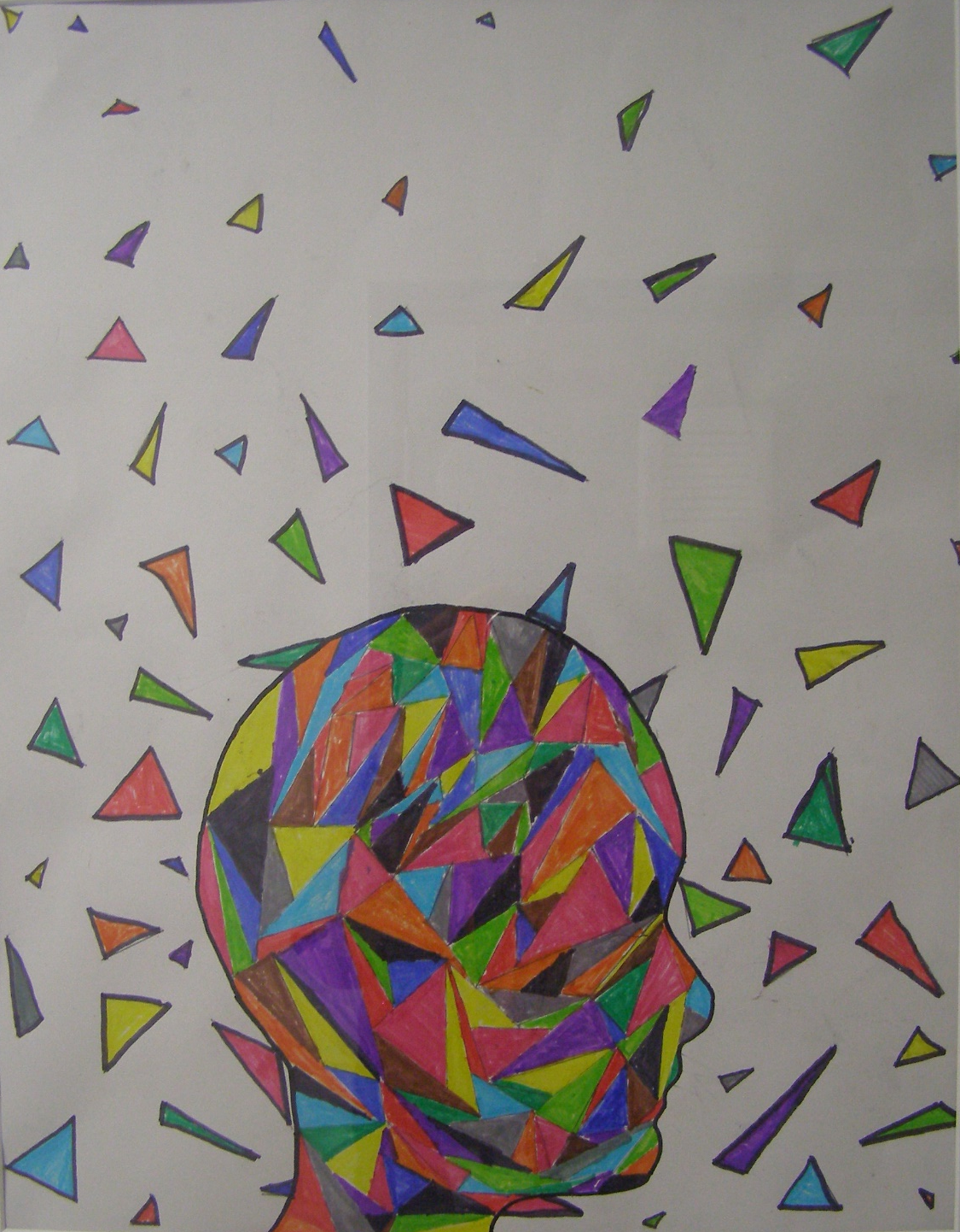
Genesis chapters 6-9
The Story of Noah and The Ark
“When Noah was six hundred years old…”
Resilient
I can keep trying new strategies until I understand
I can keep going even when I find it difficult
I never give up - I enjoy challenges
I can keep trying, if I get something wrong
I can use mistakes as opportunities to learn
I can practise lots

Slide 6
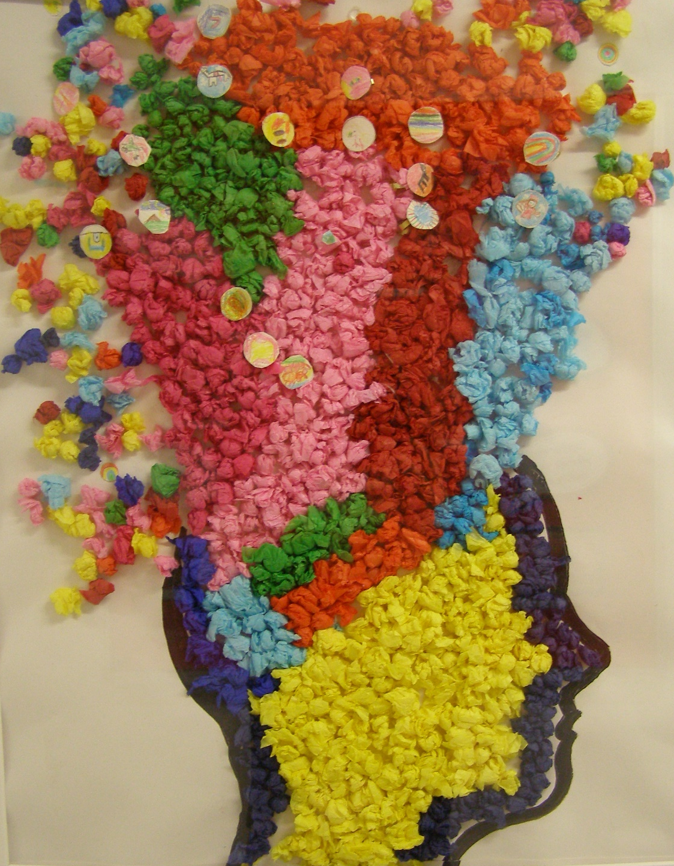
Genesis chapters 1 - 4
The Creation story
“Then God commanded, “ Let the water be filled with many kinds of living beings…”
Imaginative
I can let my imagination be free
I can think of wonderful, unusual ideas
I can use my creative brain in all my learning
I can be inspired and think differently
I can be original and inventive
I can have fun being a creative learner

Slide 7
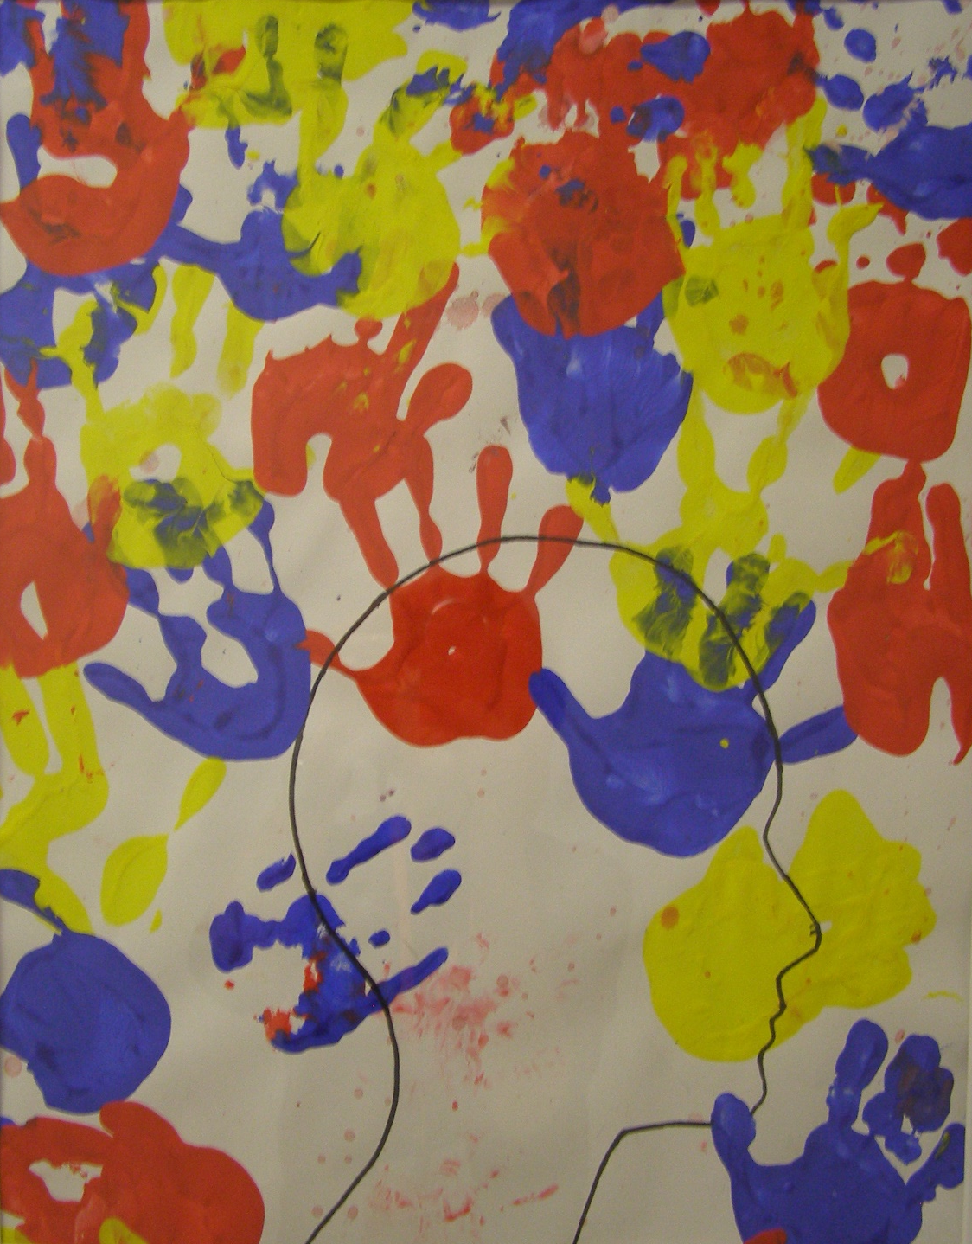
Luke chapter 10
The Story of The Good Samaritan “Jesus answered, “There was once a man who was going down from Jerusalem to Jericho when robbers attacked him…”
Inclusive
I can explain things to help others
I can recognise that everybody has something to contribute
I can listen to others and value what they say
I can play, talk and work with different people
I can be kind when I disagree
I can recognise strengths in other people

Slide 8

The Book of Ruth chapter 1
Ruth and Naomi –
“When Naomi heard in Moab that the LORD had come to the aid of his people by providing food for them, she and her daughters-in-law prepared to return home from there…”
Confident
I believe and trust in myself
I can have a different point of view
I can use what I have learnt to help myself
I can ask questions and join in discussions
I can speak clearly and express my ideas
I can smile while I am learning and ‘ go for it’

Slide 9

Exodus chapter 2
The Story of Moses in the Bulrushes “When she saw that he was a fine child, she hid him for three months…”
Resourceful
I can find things to help me
I can look for answers
I Know what to do if I get stuck
I can be a resource for my own learning
I Know what to ask and how to ask
I can talk to a partner and share good ideas

Slide 10

Luke chapter 2
The Nativity Story – Mary and Joseph
“At that time a proclamation was made by Caesar Augustus…”
Determined
I can try to be better than last time
I can be patient and give myself time
I can improve one thing at a time
I can say ‘I can’
I can use the WILF to help me achieve my learning
I can take small steps towards achieving my targets

Slide 11
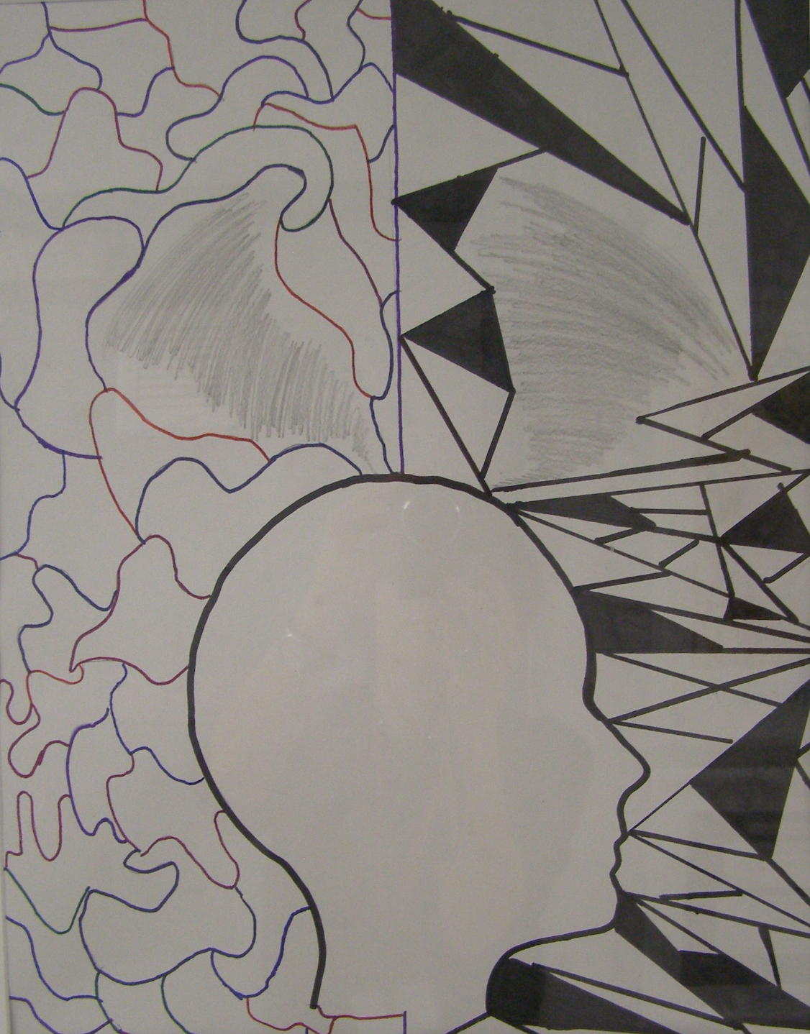
John chapter 6
The Feeding the five Thousand
“Another of his disciples, Andrew, Simon Peter’s brother, spoke up, 9 “Here is a boy with five small barley loaves and two small fish, but how far will they go among so many?...”
Flexible
I can look for patterns and connections
I can try something different
I can look at things differently
I can stretch my brain and take on challenges
I can express myself in different ways
I can try different ways to achieve my learning

Slide 12

Luke chapter 1
Mary and the Angel Gabriel
“Six months after Elizabeth had become pregnant, God sent the angel Gabriel to Nazareth, a city in Galilee…”
Responsive
I can join in discussions
I can actively engage in my learning
I can use thinking time to help me answer questions
I can listen and respond to feedback
I can listen to others and respond to what they say
I can use a talking partner to explore my thinking

Slide 13
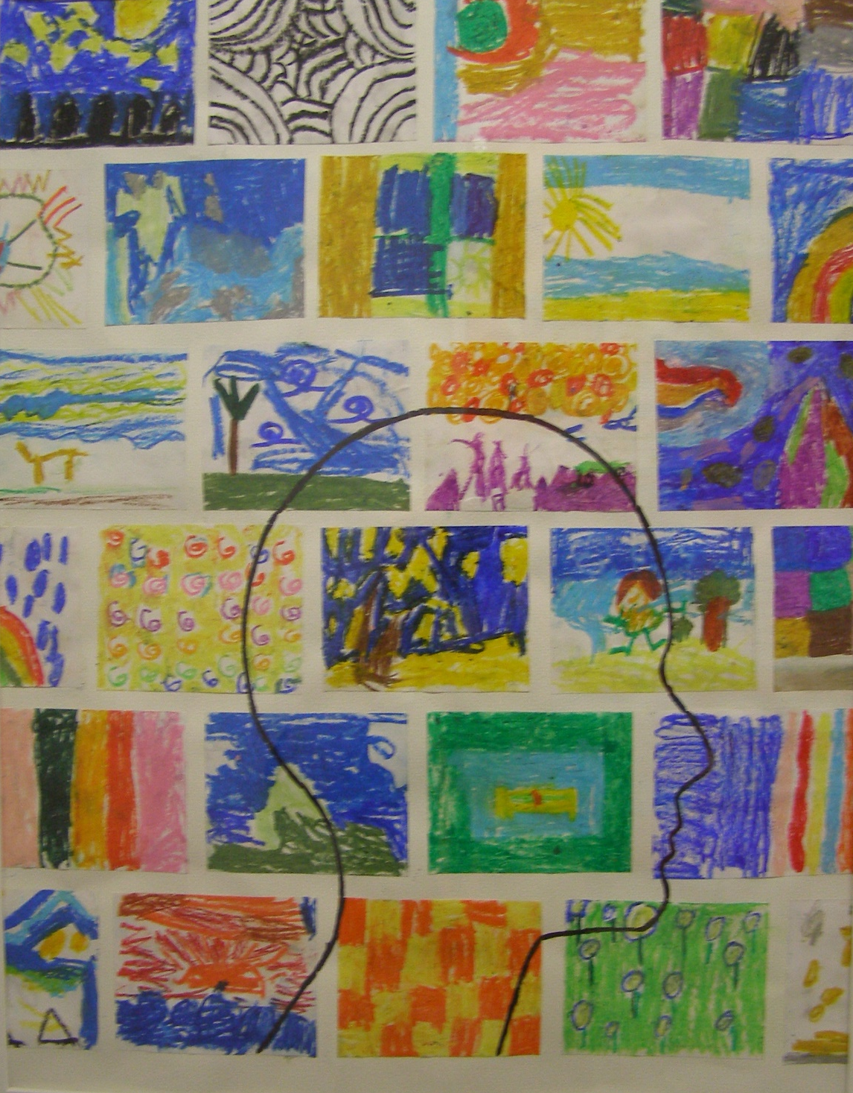
Exodus Chapter 14
Moses leaves Egypt14 Then the Lord said to Moses,… ²
Independent
I can take time to think before asking for help
I can take responsibility for my learning
I can reflect on what I know
I can try and solve problems without an adult
I believe in my own ideas
I can make good choices about my learning

Slide 14

1 Samuel chapter 17
The Story of David and Goliath
“A champion named Goliath, who was from Gath, came out of the Philistine camp…”
Focused
I can manage distractions
I can get absorbed in a task
I can plan and think things through
I can maximise my learning time
I can be organised and ready to learn
I can jot down things that help me think

